Slide 1
Local Search Algorithms And Optimization Problems
In many optimization problems, the path to the goal is irrelevant; the goal state itself is the solution.
The best state is identified from the objective function or heuristic cost function.
In such cases, we can use local search algorithms (ie) keep only a single current state, try to improve it instead of the whole search space explored so far.
For example, in the 8-queens problem, what matters is the final configuration of queens, not the order in which they are added.
Local search algorithms operate a single current state (rather than multiple paths) and generally move only to neighbours of that state.
Typically, the paths followed by the search are not retained.

Slide 2
They have two key advantages:
(1) They use very little memory-usually a constant amount;
(2) They can often find reasonable solutions in large or infinite (continuous) state spaces for which systematic algorithms are unsuitable.
The local search problem is explained with the state space land scape. A landscape has:
Location - defined by the state
Elevation - defined by the value of the heuristic cost function or objective function, if elevation corresponds to cost then the lowest valley (global minimum) is achieved. If elevation corresponds to an objective function, then the highest peak (global maximum) is achieved.

Slide 3
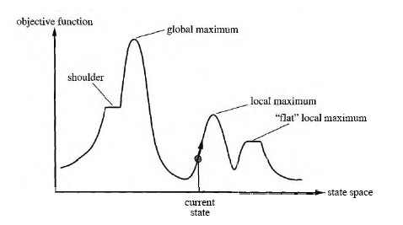
A complete local search algorithm always finds a goal if one exists, an optimal algorithm always finds a global minimum/maximum.
A one-dimensional state space landscape in which elevation corresponds to the objective function.

Slide 4
Applications
Integrated - circuit design
Factory - floor layout
Job-shop scheduling
Automatic programming
Vehicle routing
Telecommunications network Optimization

Slide 5
Advantages
Constant search space. It is suitable for online and offline search
The search cost is less when compare to informed search
Reasonable solutions are derived in large or continuous state space for which systematic algorithms are unsuitable.
Some of the local search algorithms are:
Hill climbing search (Greedy Local Search)
Steepest Ascent Hill Climbing
3. Simulated annealing

Slide 6
Hill Climbing Search (Greedy Local Search)
The hill-climbing search algorithm is simply a loop that continually moves in the direction of increasing value.
It terminates when it reaches a "peak" where no neighbor has a higher value.
The algorithm does not maintain a search tree, so the current node data structure need only record the state and its objective function value.
At each step the current node is replaced by the best neighbour.

Slide 7
Hill-climbing search algorithm
function
HILL-CLIMBING(problem)
returns
a state that is a local maximum
inputs:
problem, a problem
local variables:
current, a node
and neighbor, a node
current <-
MAKE-NODE(INITIAL-STATE[problem])
loop do
neighbor <-
a highest-valued successor of current
if
VALUE[neighbor] <= VALUE[current]
then return
STATE[current]
current <- neighbor

Slide 8
To illustrate hill-climbing, we will use the 8-queens, where each state has 8 queens on the board, one per column.
The successor function returns all possible states generated by moving a single queen to another square in the same column (so each state has 8 x 7 = 56 successors).
Hill-climbing algorithms typically choose randomly among the set of best successors, if there is more than one.
The heuristic cost function h is the number of pairs of queens that are attacking each other, either directly or indirectly.
The global minimum of this function is zero, which occurs only at perfect solutions.

Slide 9
n x n queens board (n=4)
 | Q |  | Q
Q |  | Q
 | Q
 |  |  | Q
Q |  | Q
 | Q
 |  |  | Q
Q
 |  | Q
h=5
h=2
h=0

Slide 10
Q
 | Q | Q | Q
 | Q
Q |  | Q | Q
 |  | Q
Q | Q |  | Q
 |  |  | Q
Q | Q | Q
H=3
H=3
H=3
H=3
Q
 | Q | Q | Q
 | Q
Q |  | Q | Q
 |  | Q
Q | Q |  | Q
 |  |  | Q
Q | Q | Q
H=3
H=3
H=3
H=3
Q
 | Q | Q | Q
 |  | Q
Q | Q |  | Q
 |  |  | Q
Q | Q | Q
 | Q
Q |  | Q | Q
H=3
H=2
H=2
H=3

Slide 11
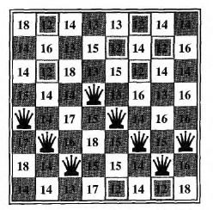
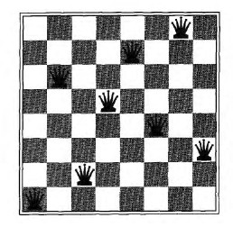
An 8-queens state with heuristic cost estimate h = 17, showing the value of h for each possible successor obtained by moving a queen within its column. The best moves are marked.

Slide 12

Hill climbing often gets stuck for the following reasons
Local maxima or foot hills : a local maximum is a peak that is higher than each of its neighboring states, but lower than the global maximum.
Example :
The evaluation function value is maximum at C and from their there is no path exist for expansion.
Therefore C is called as local maxima.
To avoid this state, random node is selected using back tracking to the previous node.

Slide 13

Plateau or shoulder: a plateau is an area of the state space landscape where the evaluation function is flat.
It can be a flat local maximum..
Example :
The evaluation function value of B C D are same, this is a state space of plateau.
To avoid this state, random node is selected or skip the level (i.e) select the node in the next level

Slide 14
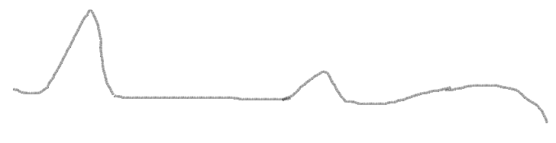
Ridges: Ridges result in a sequence of local maxima that is very difficult for greedy algorithms to navigate.
But the disadvantage is more calculations to be done that correspond to moving in several directions at once.
Structure of hill climbing drawbacks
Local maxima
Ridge
Plateau
Goal state

Slide 15
Variants of hill-climbing
First-choice hill climbing - First-choice hill climbing implements stochastic hill climbing by generating successors randomly until one is generated that is better than the current state
Steepest Ascent Hill Climbing
Simple Hill Climbing considers all the moves from the current state and selects the best one as the next state.
(a)Stochastic hill climbing - Stochastic hill climbing chooses at random from among the uphill moves;
the probability of selection can vary with the steepness of the uphill move.
Simulated Annealing
It is a variation of hill climbing in which ,at the beginning of the process ,some downhill moves may be made.
(a)Random-restart hill climbing - Random-restart hill climbing adopts the well known adage, "If at first you don't succeed, try, try again.“
It conducts a series of hill-climbing searches from randomly generated initial state, stopping when a goal is found.

Slide 16
Steepest Ascent Hill Climbing (Gradient Search)
Algorithm
1.Evaluate the initial state. If it is a goal state, then return it and quit. Otherwise continue with the initial state as the current state.
2. Loop until a solution is found or until a complete iteration produces no change to current state.
(a)Let SUCC be a state such that any possible successor of the current state will be better than SUCC.
(b)For each operator that applies to the current state do
(i) Apply the operator and generate a new state.
(ii)Evaluate the new state ,If it is a goal state, then return it and quit. If not compare it to SUCC. If it is better ,then set SUCC to this state. If it is not better leave SUCC alone.
(c )IF the SUCC is better than current state,then set current state to SUCC

Slide 17
Simulated Annealing
Metals are melted and then gradually cooled until some solid state is reached.
Downhill moves are allowed anytime.
Large upward moves may occur early on
But as the process progresses, only relatively small upward moves are allowed until finally the process converges to a local minimum configuration.
AI-FDP/RiT

Slide 18
Simulated annealing search
An algorithm which combines hill climbing with random walk to yield both efficiency and completeness.
In metallurgy, annealing is the process used to temper or harden metals and glass by heating them to a high temperature and then gradually cooling them.
When the search stops at the local maxima, we will allow the search to take some down Hill steps to escape the local maxima by allowing some "bad" moves but gradually decrease their size and frequency.
The node is selected randomly and it checks whether it is a best move or not.
If the move improves the situation, it is executed.

Slide 19
∆ E variable is introduced to calculate the probability of worsened.
A Second parameter T is introduced to determine the probability, which measures temperature.
This algorithm was developed using annealing process the process of gradually cooling a liquid until it freezes.
The function VALUE corresponds to the total energy of the atoms in the material and T corresponds to the temperature.
The variable schedule determines the rate at which the temperature is lowered.

Slide 20
The simulated annealing search algorithm
function
SIMULATED – ANNEALING (problem, schedule)
returns
a solution
state
inputs:
problem , a problem
schedule,
a mapping from time to “temperature”
local variables:
current,
a node
Next,
a node
T, a “variable”
controlling the probability of downward steps
current
<-
MAKE – NODE (INITIAL – STATE [problem])
for
t
<-
1 to ∞ do
T
<-
schedule[t]
if
T = 0
then return
current
next
<-
a randomly selected successor of current
∆ E
<-
VALUE[next]
-
VALUE[current]
0
next
if
∆ E
>
then
current
<-
else
next only with probability
e∆ E^{/T}
current
<-

Slide 21
The algorithm :
Start with evaluating the initial state.
Apply each operator and loop until a goal state is found or till no new operators left to be applied as described below:
  Set T according to an annealing schedule.
  Select and apply a new operator.
  Evaluate the new state. If it is a goal state quit.
∆E = Val (current state) – Val (new state)
If ∆E < 0 then this is the new current state.
Else find a new current state with probability e – E/ KT

Slide 22
Property of simulated annealing search
T decreases slowly enough then simulated annealing search will find a global optimum with probability approaching one
Applications
VLSI layout
Airline scheduling

